Slide 1
UJALA
Government of India

Slide 2
Domestic Efficient Lighting Program(DELP) Now UJALA
DELP and SLNP
Hon’ble Prime Minister of India(Sh. Narendera Modi) launches scheme for LED bulb distribution under Domestic Efficient Lighting Programme in Delhi on 5th January 2015

Slide 3
Advantages of LED
 | LED(Under UJALA) | CFL | ICL
Watt | 9 | 14/18 | 60/100
Energy Efficiency | 88% | 50% | 0%
Annual Cost Saving in the Electricity Bill (Per Bulb) | INR 165-400 | INR 85.5 | Nil
Life Expectancy(Hours) | 25,000 | 8,000 | 12,00
Free of Cost Warranty | 1 Years | 1 Year | Nil
DELP and SLNP
MRP | COMMISSION
60 | 5
70 | 7
Product in pipe line- BEE 5 Star Bulb , 900 lumen in 7 watt
Expected date – May, 2021
GOVT.
PVT.

Slide 4
Power Consumption- 35 Watt
Sweep Size-1200 mm
Service value- ≥ 6.0
DELP and SLNP
Expected date – May, 2021

Slide 5
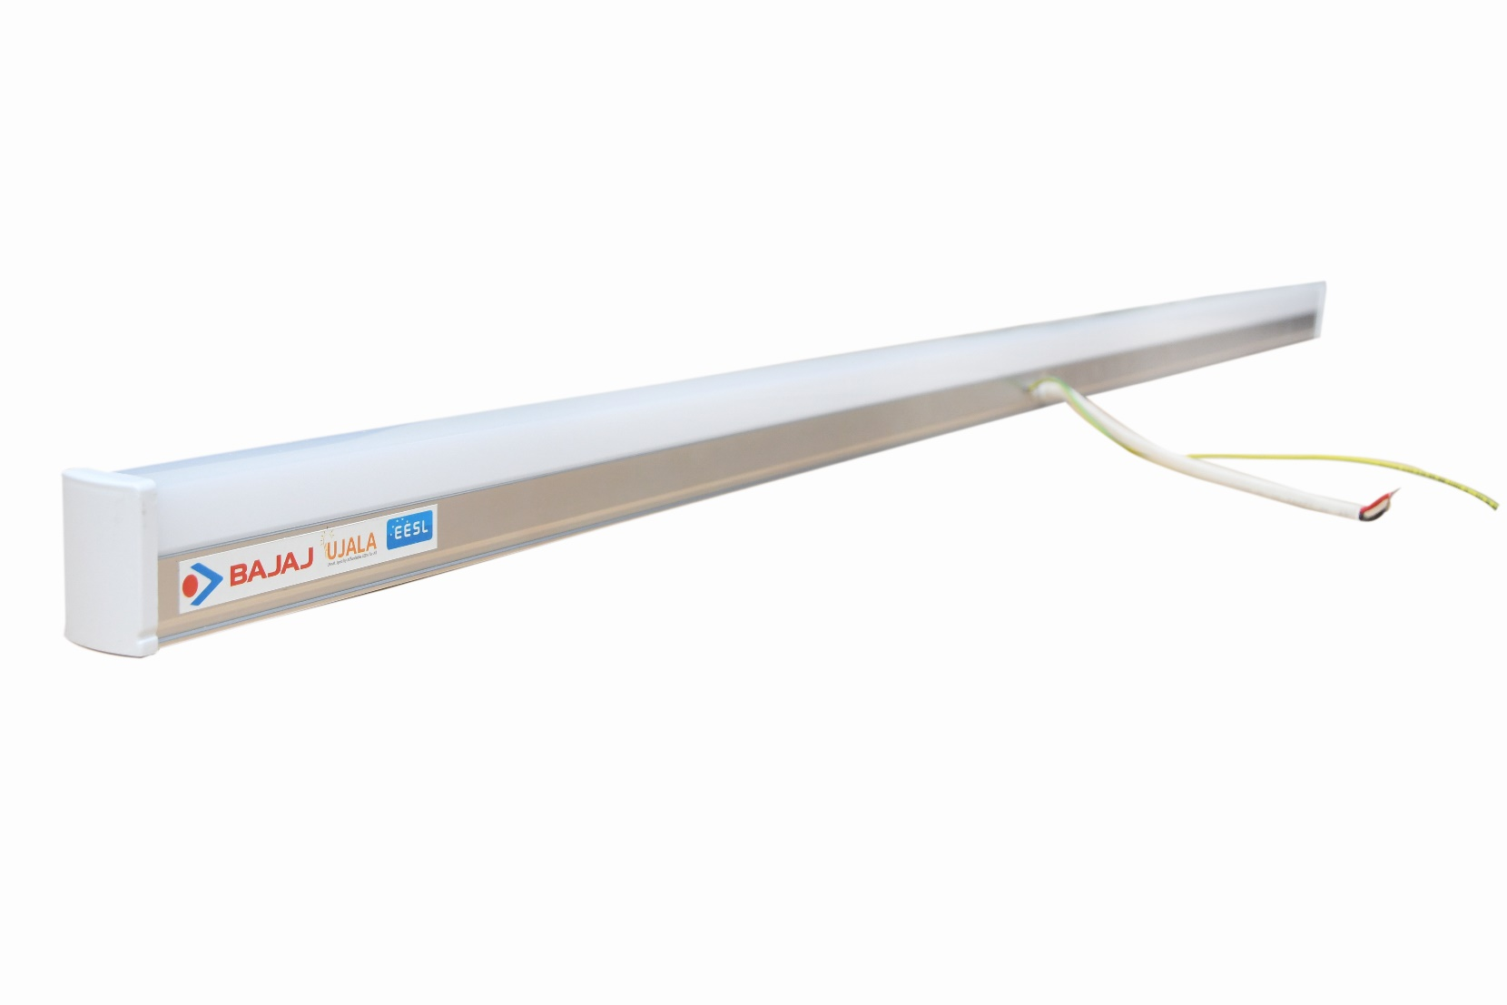
Power Consumption- 20 watt
Lumen Output- 2000 lumen
Base- Aluminium base for proper heat dissipation
MRP | COMMISSION
250 | 10
270 | 14
GOVT.
PVT.

Slide 6
DELP and SLNP

