Slide 1


Brain-Storming
Session
on
RAISE
April 2021

Slide 2

Why RAISE
IAQ in the context of Covid 19 and other communicable diseases
Businesses and organizations are expanding
Increased demand of Smart Homes/Green Buildings
Integral to energy efficiency in HVAC
Increased industrialization to fuel GDP growth
Government initiatives – smart cities
Compliance with IAQ norms
  US Embassy distributed 58 low cost AQI monitors in North India in Feb 2020
  BMC is installing 90 CAAQMS across city
  NTPC in talks with CPCB for funding 25 CAAQMS in 6 states and 3 UTs

Slide 3
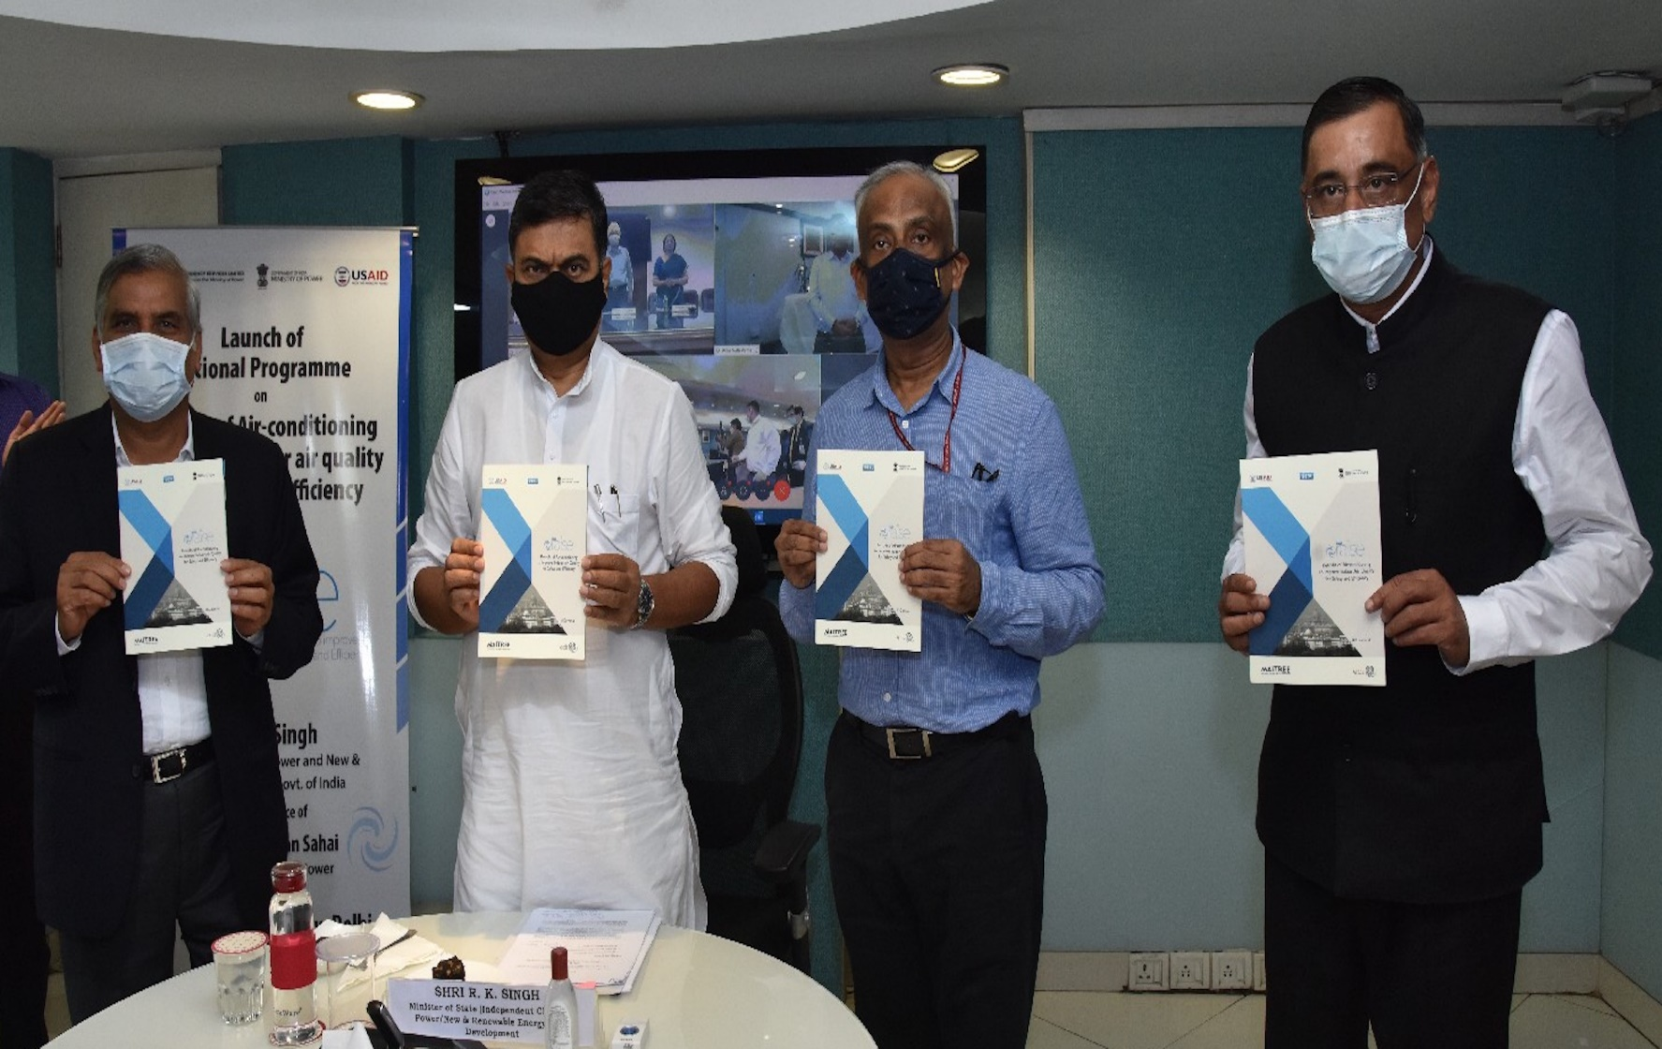
EESL – Study Case
Project Implemented on World Environment Day – 5th June 2020
Technical Collaboration with U.S. Agency for International Development (USAID)’s, Market Integration and Transformation Program for Energy Efficiency (MAITREE)

Slide 4
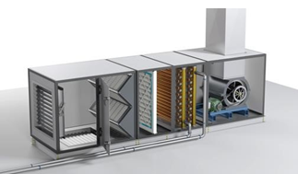
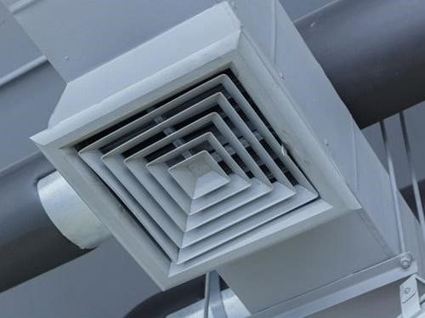
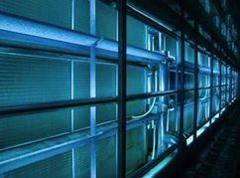
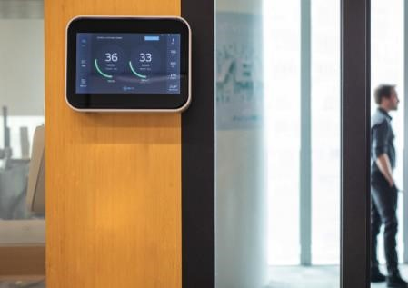
EESL – Study Case
RAISE Implemented at EESL’s Scope Complex Office in New Delhi
IAQ improved by 95% through-out office use time on all floors
3 pronged approach –
  Cut-off source of pathogens through filtration system
  Dilute pathogen population through monitored FAD
  UVC Germicidal Irradiation to reduce pathogen growth
Incidental Energy Savings
Real Time Monitoring of IAQ
As per ISHRAE standards
Temperature range should be 24 to 30 °C
Relative Humidity between 40 to 70%
Fresh Air Requirement 8.5cum/hr per person plus 1.1 cum per hour per sq mtr of conditioned space

Slide 5
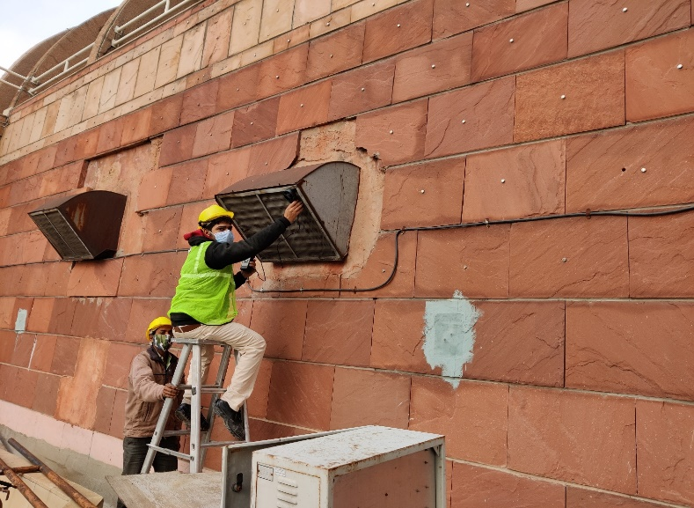
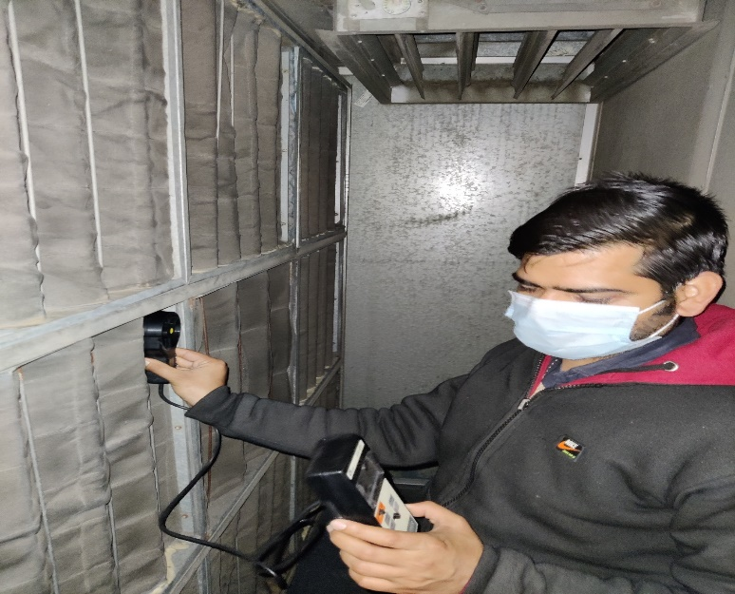
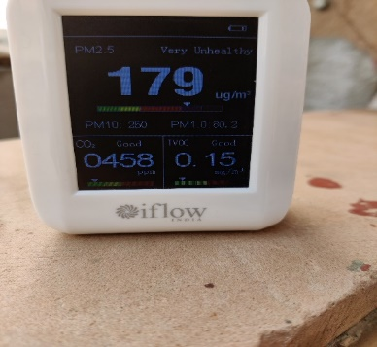
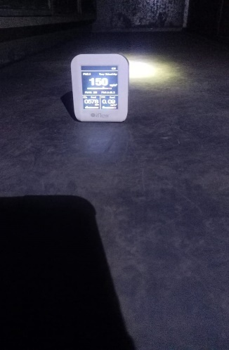
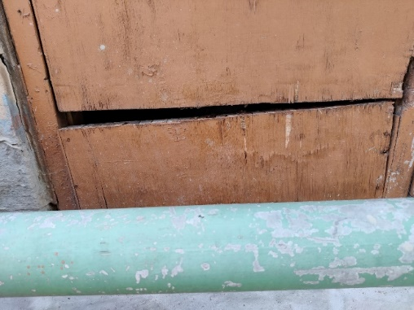
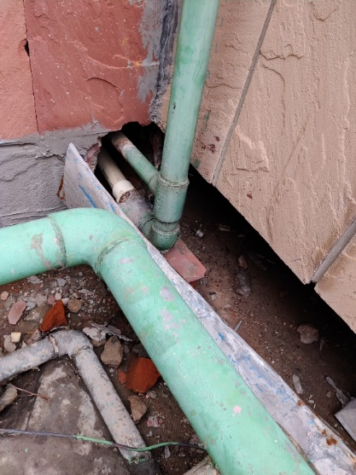
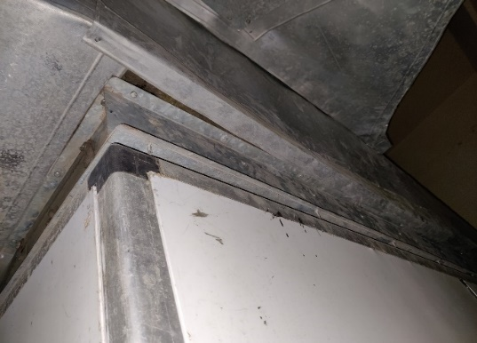
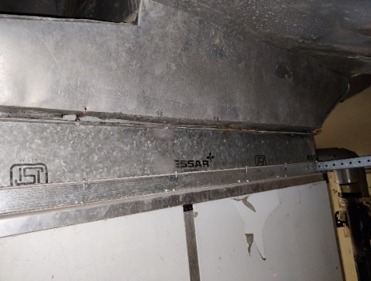
Project Pics

Slide 6
System Architecture

Slide 7
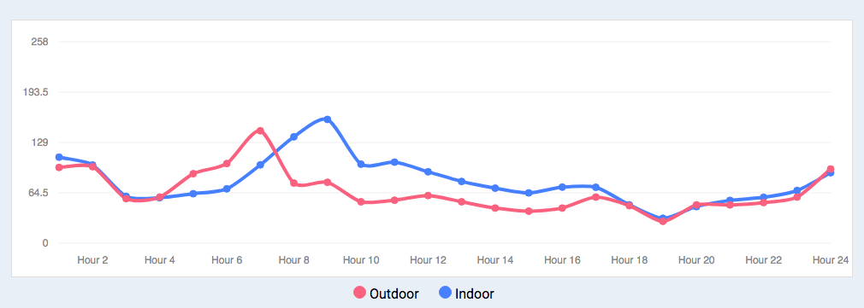
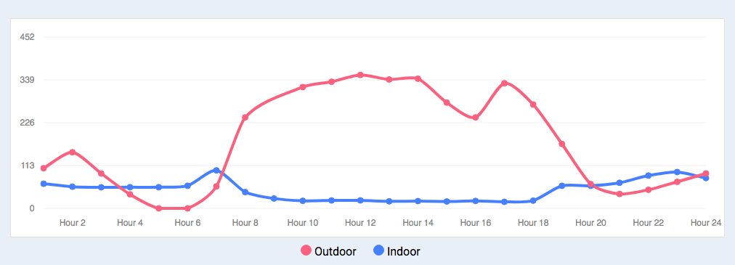
EESL – Study Case
In absence of project, IAQ tracks OAQ and existing HVAC system is not sufficient to maintain healthy IAQ
After RAISE implementation, the IAQ levels are 95% better as compared to OAQ for all sections in the building
95% reduction in pollution level indoors

Slide 8
UVC Germicidal Irradiation

Slide 9
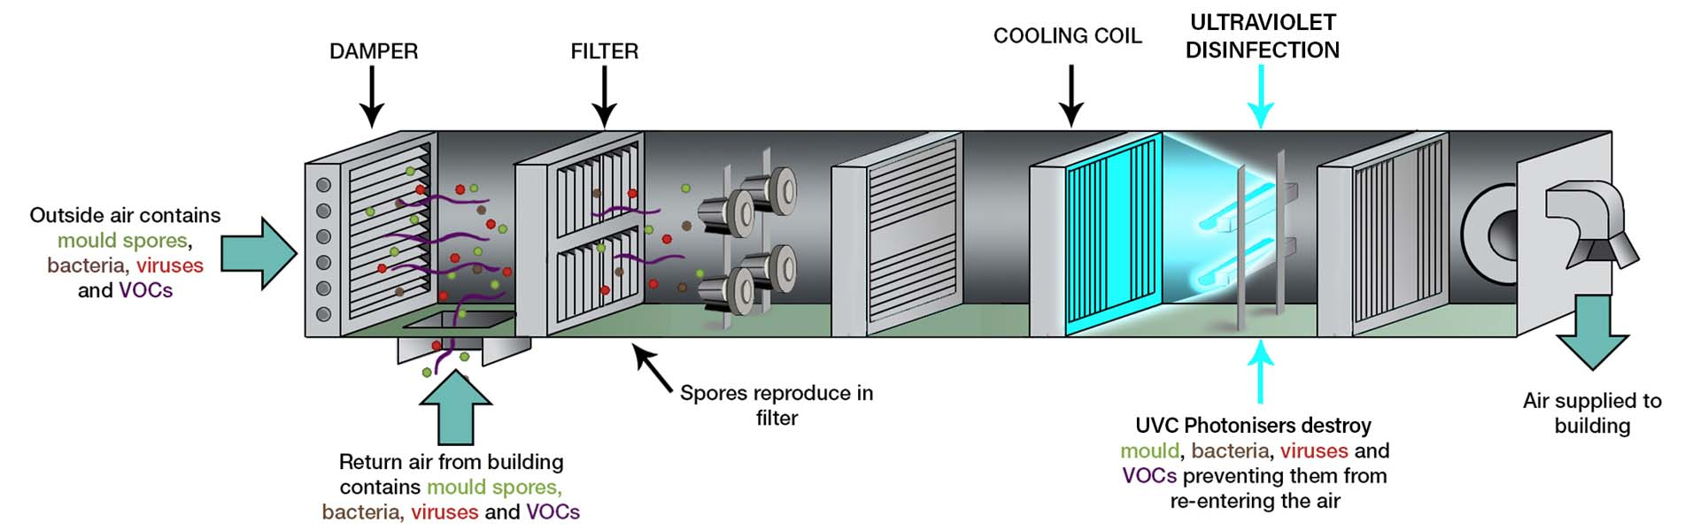
UVC Germicidal Irradiation
Pre-filter Stage – larger particles like hair, wool, pollens
EAC or ESP Filter – smaller particulates PM 10, smoke (optional)
Activated Caron Filter – final stage that filters out odors, PM2.5, VOCs, gases
https://www.airconditioning-systems.com/electronic-air-cleaners.html

Slide 10
RAISE Trademark ® - USP
Class | Trade Mark number | Area of business | Validity
35 | 4548747 | RAISE – Providing Business Consulting Services for the management of air-conditioning, ventilation systems, IAQ and environment | 29/06/2030
37 | 4548748 | RAISE – Providing construction supervision & management services (including R&M) in the areas of air-conditioning, ventilation systems, IAQ and environment | 29/06/2030
42 | 4548749 | RAISE – Design & Development of services for air-conditioning, ventilation systems, IAQ and environment including testing/research and environmental safety | 29/06/2030
42 | 4548752 | EESL - Design & Development of services for air-conditioning, ventilation systems, IAQ and environment including testing/research and environmental safety | 29/06/2030

Slide 11
RAISE – Pricing Advantage
BOQ PRICING DETAILS FOR RAISE COMPONENTS (1 +2 YEARS AMC)
Item Name | Supply | Installation | AMC-1 | AMC-2 | Unit Rate | After PMC | Channel Partner
Filter System | 25.2 | 2.8 | 5.6 | 5.6 | 39.2 | 44.7 | 45.8
Monitoring Station | 36.0 | 4.0 | 8.0 | 8.0 | 56.1 | 63.9 | 65.5
TFA | 37.1 | 3.7 | 8.2 | 8.2 | 57.1 | 65.1 | 66.7
Filter fo TFA | 13.2 | 1.5 | 2.9 | 2.9 | 20.5 | 23.4 | 24.0
Cooling Coil Unit | 6.0 | 0.8 | 1.4 | 1.4 | 9.5 | 10.8 | 11.1
HRU (Sensible Heat) | 98.8 | 10.1 | 21.8 | 21.8 | 152.5 | 173.8 | 178.1
HRU (Enthalpy) | 84.0 | 9.3 | 18.7 | 18.7 | 130.7 | 149.0 | 152.7
HRU (Dessicant) | 84.0 | 9.3 | 18.7 | 18.7 | 130.7 | 149.0 | 152.7
Outdoor Unit for TFA | 140.0 | 15.6 | 31.1 | 31.1 | 217.8 | 248.3 | 254.5
LED Display | 82792.2 | 8279.2 | 18214.3 | 18214.3 | 127500.0 | 145350.0 | 148983.8
VFD and accessories | 3.4 | 0.4 | 0.8 | 0.8 | 5.2 | 6.0 | 6.1

Slide 12
Typical Business Approach
Enquiry from customers through DA
Questionnaire to be sent to client
Filled up data format from client
MoU/Agreement with customer
Delivery of the goods to customer
Quick walkthrough survey by DA
Installation by EESL vendor
Completion Certificate
Allocation of work to vendor by EESL
Repayment by customer to EESL
Project closure
Success Fee payment to DA
PO (with payment) by customers to EESL

Slide 13
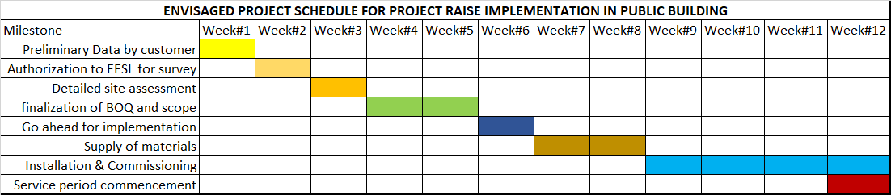
Typical Project Schedule
Client Authorisation to EESL
Authorise EESL to conduct survey
Joint finalization of site BOQ
Site audit and preparation of BOQ
Finalization of BOQ and Go-Ahead
Project Implementation and service support
Project Implementation
System Support
Provide initial building details
3 phase approach
Project to be completed in 12 weeks

Slide 14
Way Forward
Typical Market Segments
Market Segment | Specific
Government Buildings (40%) | Central/State Government
 | DISCOMs/ULBs/PSUs
 | Government Hospitals/Education
Industry (20%) | Power Plants
 | Manufacturing Units
 | PAT industries
Private Establishments (40%) | IT/ITES
 | Hotels & Malls
 | Corporates, Hospitals,

Slide 15
Way Forward
Customer Types
Business Type | Business to Business Sales (B2B) | Business to Customers Sales (B2C)
Mode of Dealing | Direct Sales to existing institutional clients | Sales to new small customers
Channel | Leverage Existing Relations | Leverage Channel Partners
Examples of customers | Corporates & PSUs, DISCOM & ULBs, Railways, State/Central Govt. | Architects, Contractors, Retailers, Builders, FMS agencies, ESCOs, audit agencies
Typical client requirements | Custom made Low Volume Large order value Lower purchase frequency | Standardized offering High customer base Lower transaction cost Higher purchase frequency
EESL pitch for customer | One stop shop Strategic pricing for cross/up-selling Confidentiality Key decision unit | Minimum Order Quantity Packaged products Special discount for bulk based on management approval Flexi payments (in future)

Slide 16
Way Forward
Way Forward
Share with EESL team to present initial estimate
Agreement/MoU with client
Audit/Survey/Implement
Identify buildings with central AC systems
Send standard concept note
Initiate preliminary discussions
Share preliminary data format and collect details

Slide 17
Registered and Corporate Office:
Energy Efficiency Services Limited
5th to 7th Floor, Core - 3, SCOPE Complex, Lodhi Road,
New Delhi - 110003, India
E: araj@eesl.co.in
W: www.eeslindia.org

